Slide 2
Linear Regression with higher dimensionality

Slide 3
Preparing the data for training the model
Splitting the data into training and testing sets
Training-X_train,Y_train
Testing-X_test,Y_test
Training and testing the model
Model evaluation

Slide 5
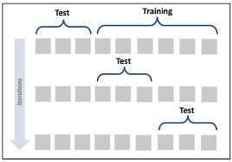
K-fold cross validation

Slide 6
Regression Metrics
Mean Squared Error (MSE)
Root Mean Squared Error (RMSE)
Mean Absolute Error (MAE)
R Squared (R²)
Adjusted R Squared (R²)
Mean Square Percentage Error (MSPE)
Mean Absolute Percentage Error (MAPE)
Root Mean Squared Logarithmic Error (RMSLE)

Slide 7
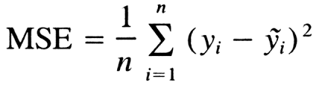
Mean Squared Error (MSE)
Advantage: Very high or low value
Disadvantage: very bad prediction, the squaring will make the error even worse

Slide 8
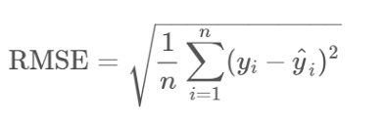
Root Mean Squared Error (RMSE)

Slide 9
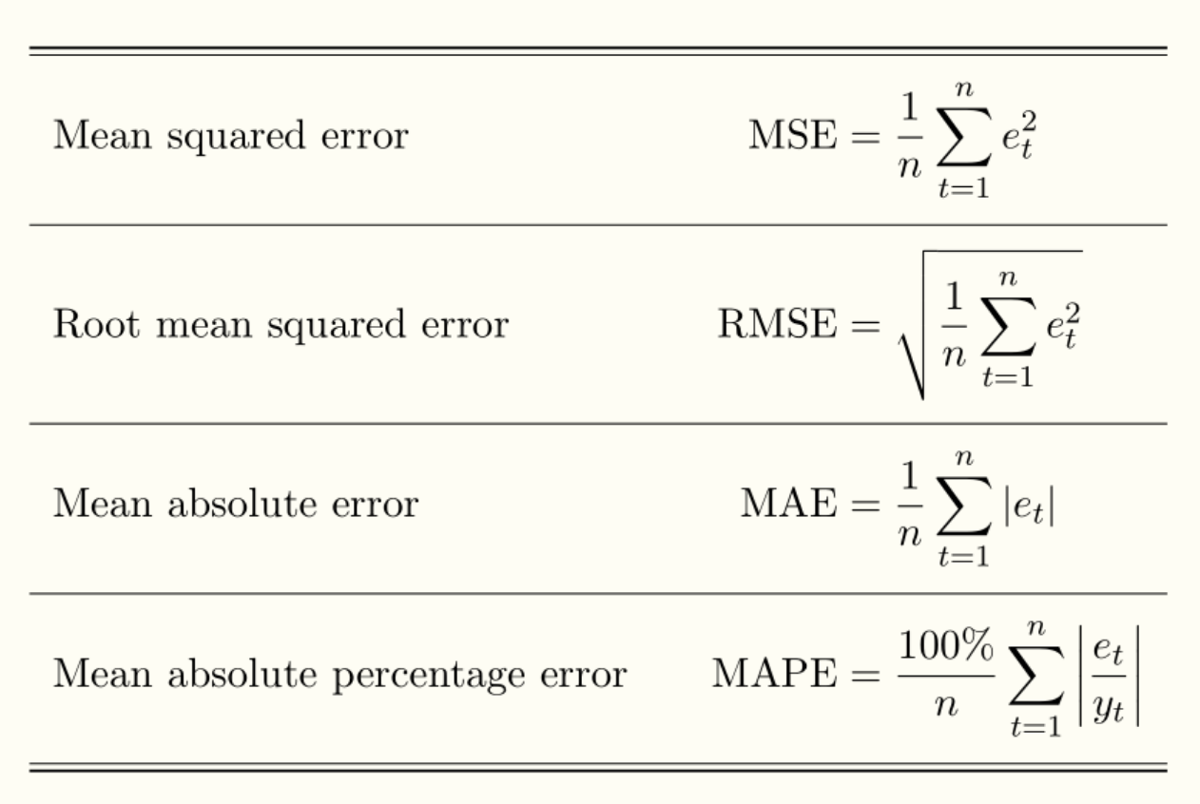

Slide 10
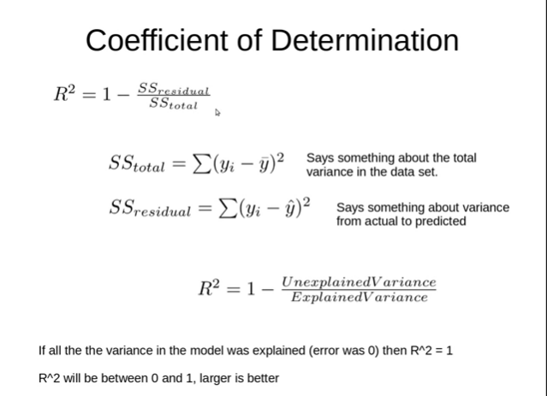
R Squared (R²)

Slide 11
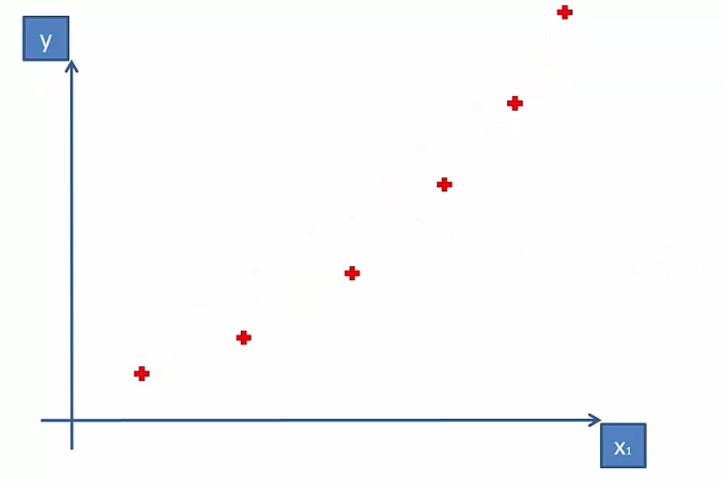
Polynomial Linear Regression

Slide 12
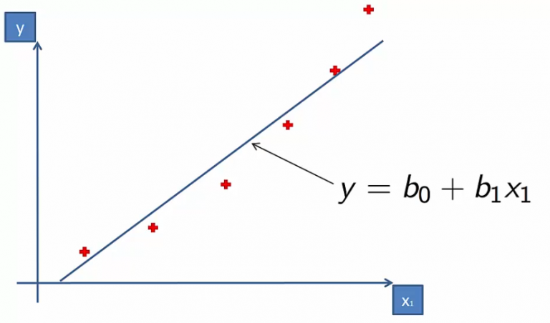

Slide 13
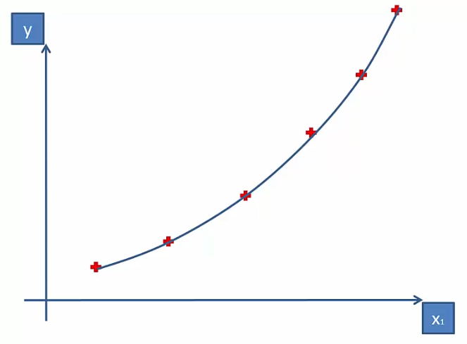

Slide 14
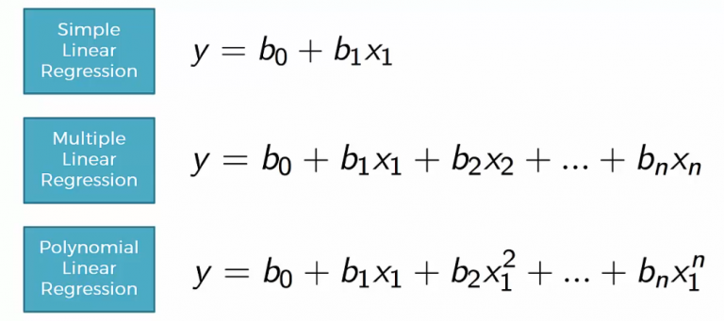

Slide 15
Problems in LR
Bias Variance trade off
Overfitting Underfitting

Slide 16
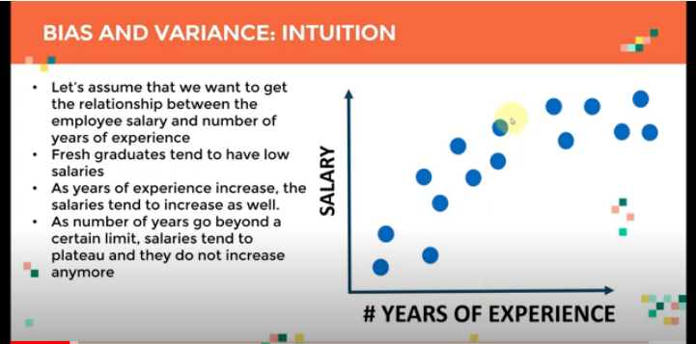

Slide 17
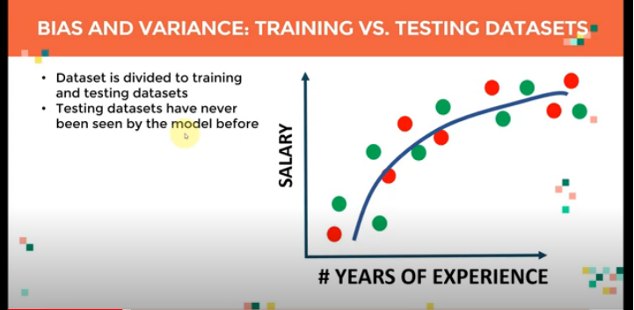

Slide 18
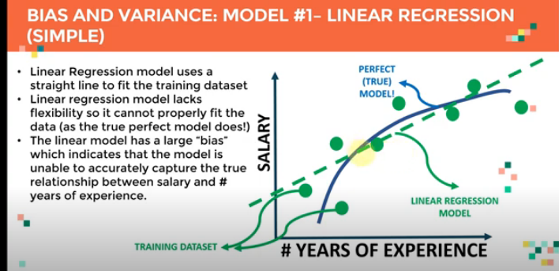

Slide 19
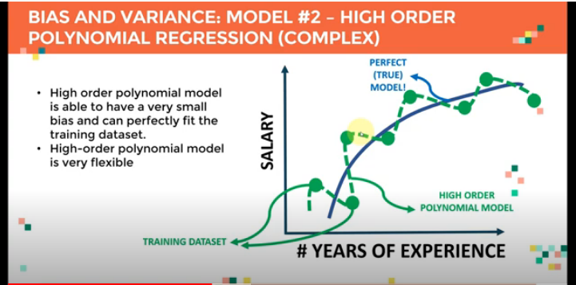

Slide 20
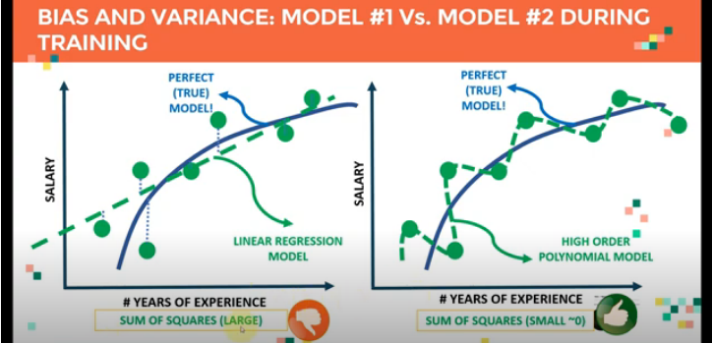

Slide 21
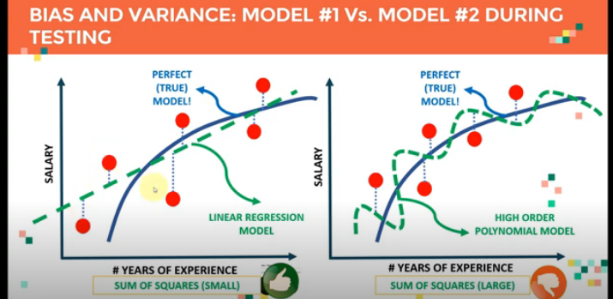

Slide 22
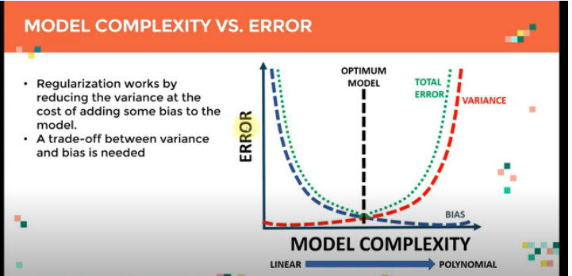

Slide 23
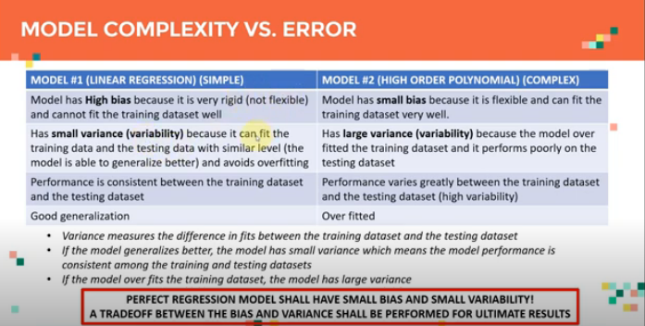

Slide 24
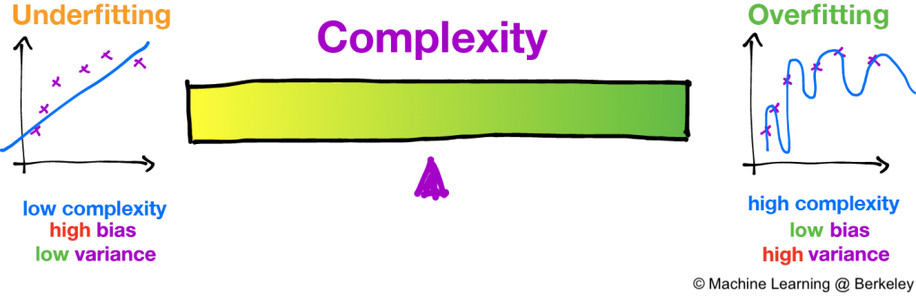
The variance error can be easily eliminated by taking many samples from different models and averaging it out which is not possible in the case of bias.

Slide 25
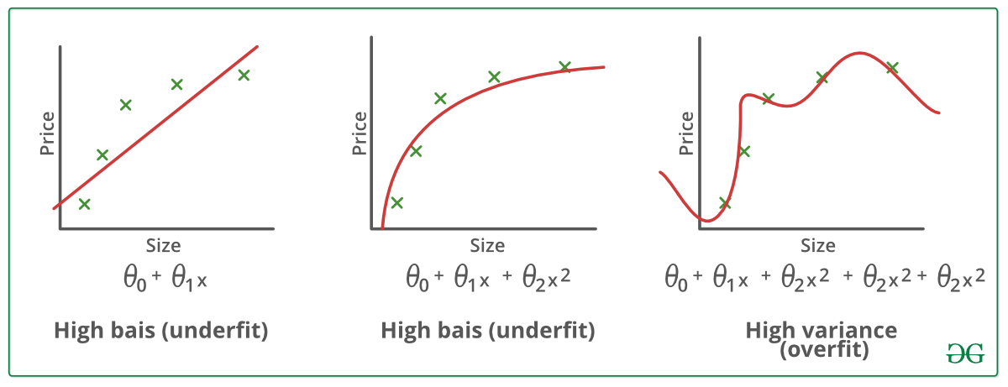


Slide 26
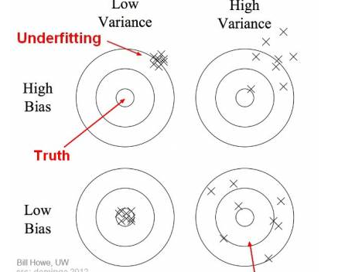

Slide 27
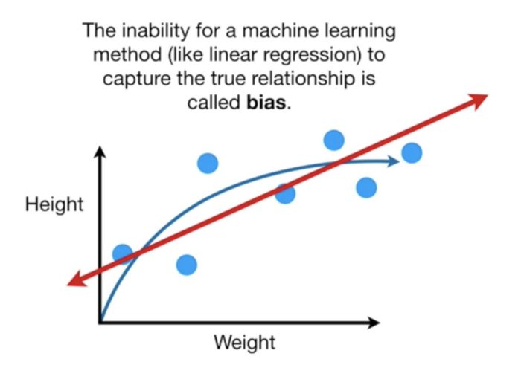

Slide 28
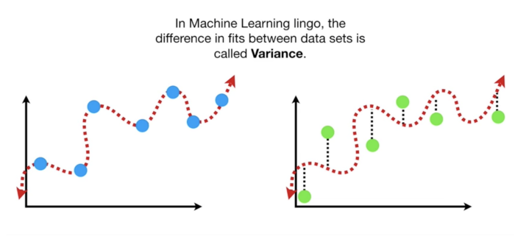

Slide 29
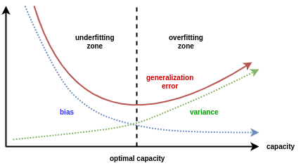

Slide 30
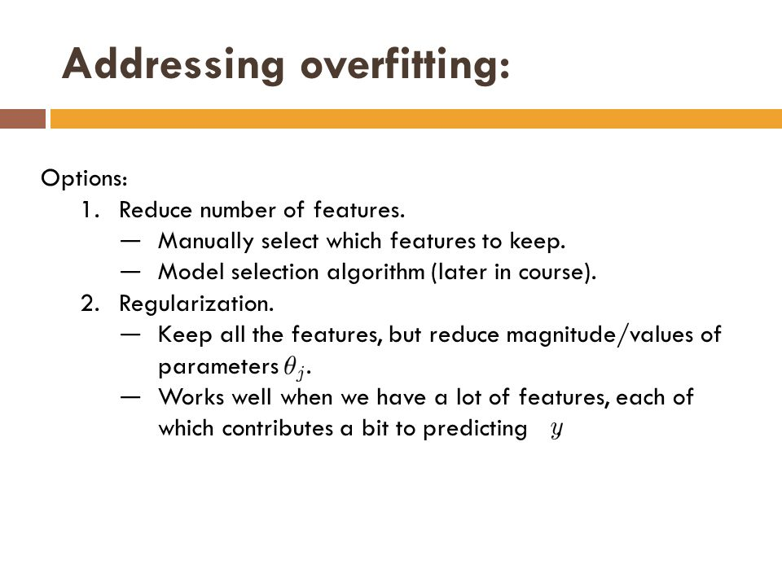

Slide 31
Regularization
Ridge and Lasso regression are some of the simple techniques to reduce model complexity and prevent over-fitting which may result from simple linear regression.

Slide 32
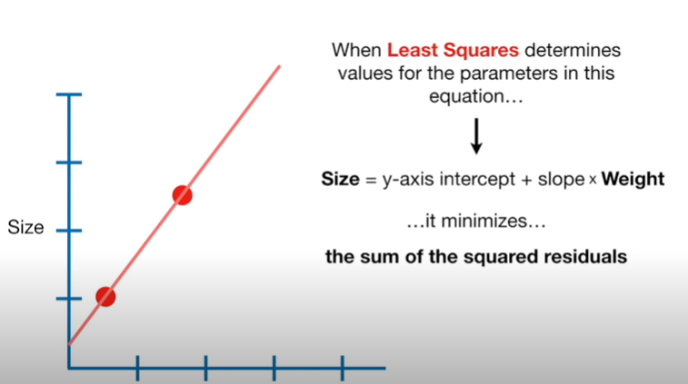

Slide 33
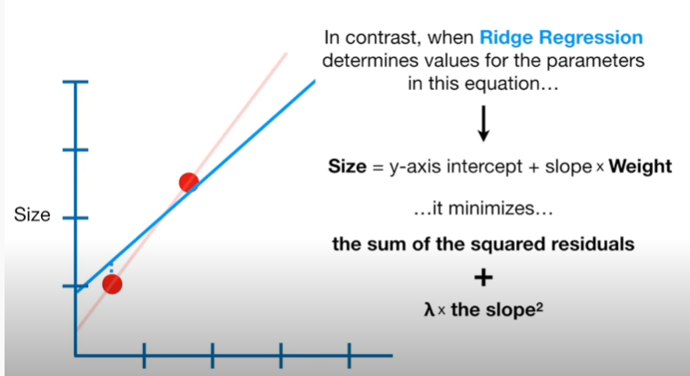

Slide 34
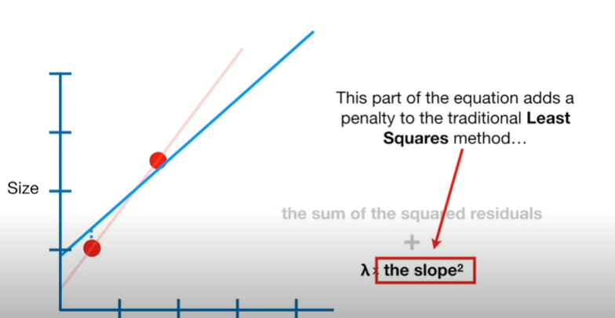

Slide 35
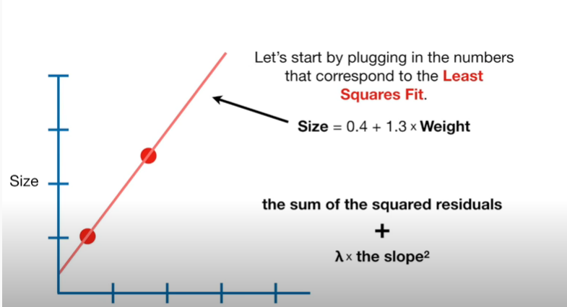

Slide 36
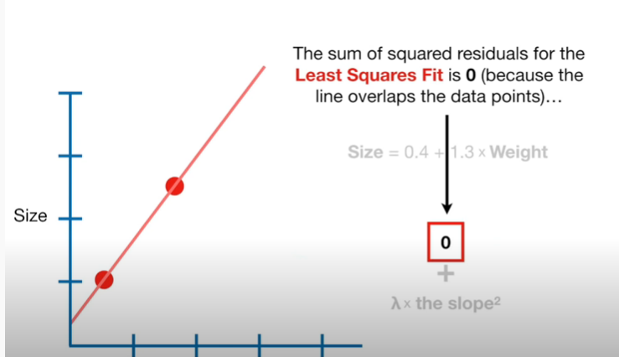

Slide 37
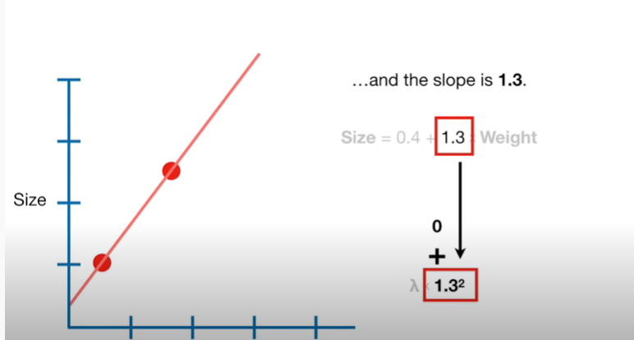

Slide 38
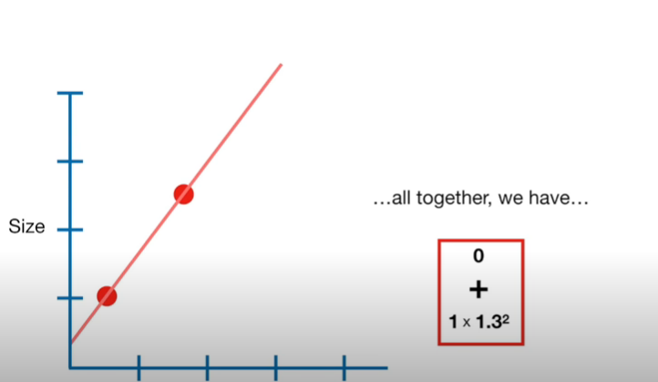

Slide 39
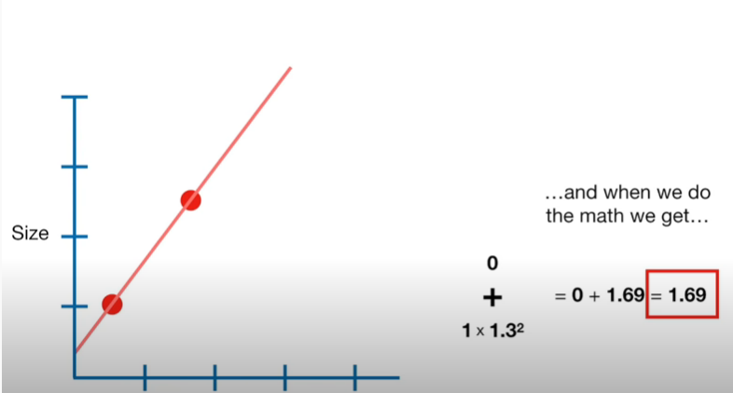

Slide 40
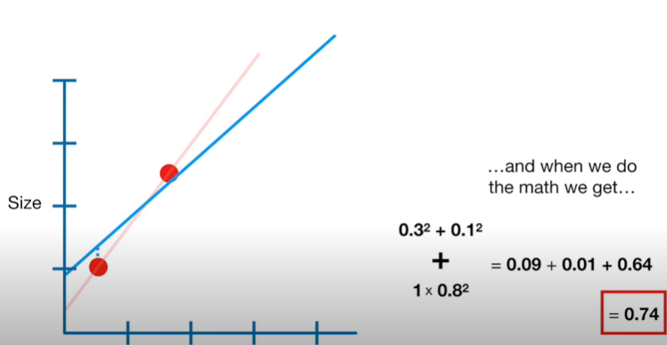

Slide 41
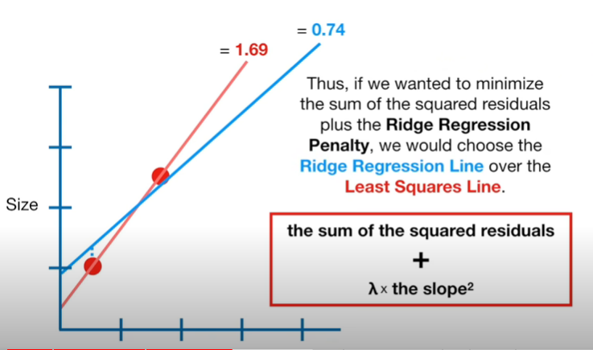

Slide 42
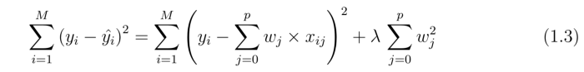
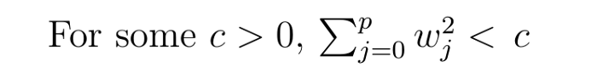
Ridge Regression :
Ridge regression (also known as Tikhonov regularization) imposes an additional shrinkage penalty to the ordinary least squares cost function to limit its squared L₂ norm:

Slide 43
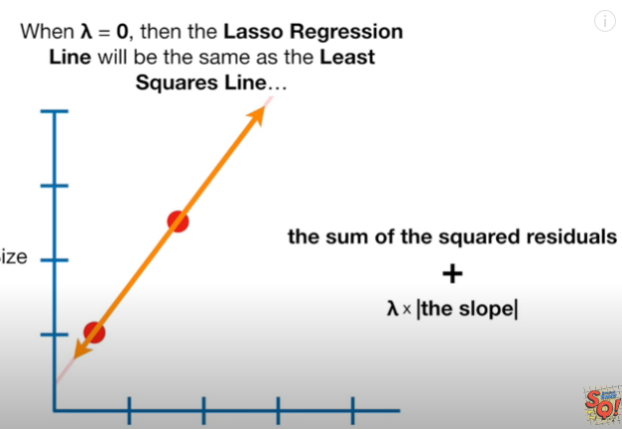

Slide 44
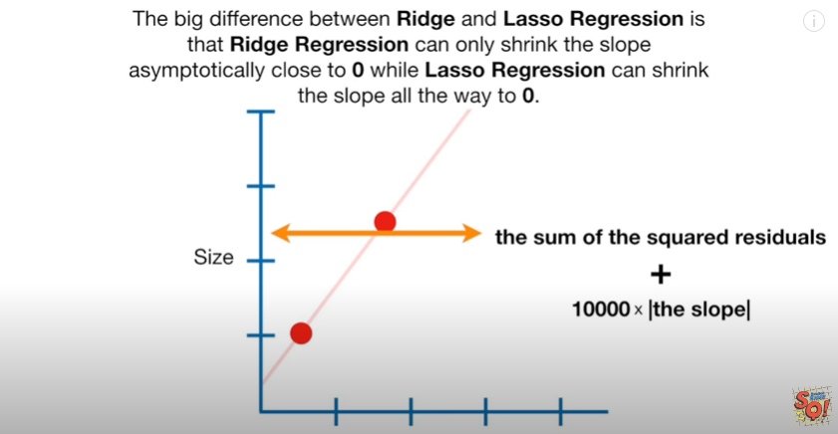

Slide 45
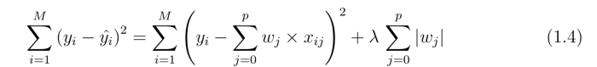
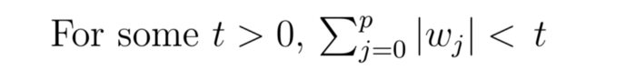
Lasso Regression
A Lasso regressor imposes a penalty on the L₁ norm of w to determine a potentially higher number of null coefficients:

Slide 46
Properties
Ridge Regression, which penalizes sum of squared coefficients (L2 penalty).
Lasso Regression, which penalizes the sum of absolute values of the coefficients (L1 penalty).
Elastic Net, a convex combination of Ridge and Lasso.

Slide 47
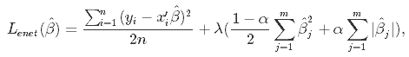
Elastic Net
combines both Lasso and Ridge into a single model with two penalty factors: one proportional to L₁ norm and the other to L₂ norm.

Slide 48
Conclusions
Lasso, Ridge, and ElasticNet: They don't modify the internal dynamics, but work as normalizers for the weights to avoid common problems when the dataset contains unscaled samples.
These penalties have specific peculiarities. While Lasso promotes sparsity, Ridge tries to find a minimum with the constraint that the weights must lie within a circle centered at the origin (whose radius is parametrized to increase/decrease the normalization strength).
ElasticNet is a mix of both these techniques, and it tries to find a minimum where the weights are small enough and a certain degree of sparsity is achieved.

Slide 49
k-Fold Cross-Validation
This approach involves randomly dividing the set of observations into k groups, or folds, of approximately equal size. The first fold is treated as a validation set, and the method is fit on the remaining k − 1 folds.
— Page 181, An Introduction to Statistical Learning, 2013.

Slide 50
What is it………
Cross-validation is a resampling procedure used to evaluate machine learning models on a limited data sample.
The procedure has a single parameter called k that refers to the number of groups that a given data sample is to be split into. As such, the procedure is often called k-fold cross-validation. When a specific value for k is chosen, it may be used in place of k in the reference to the model, such as k=10 becoming 10-fold cross-validation.

Slide 51
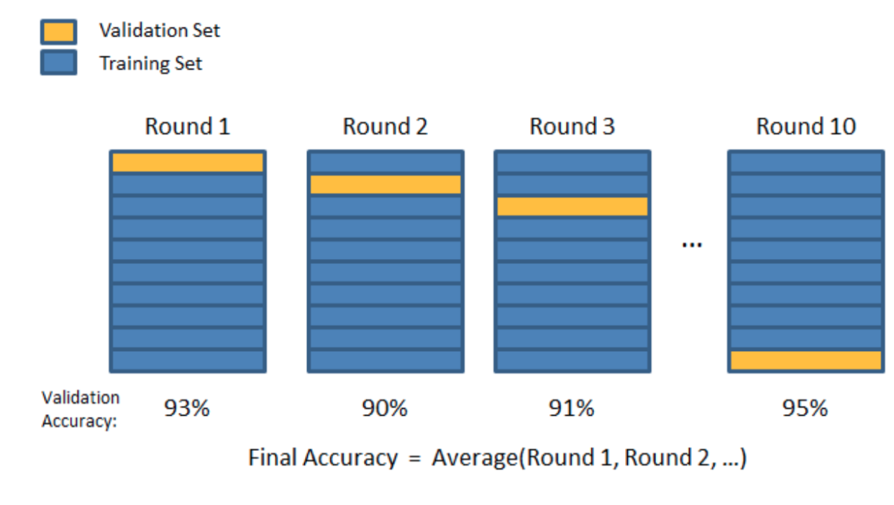
10 fold Cross validation

Slide 52
Grid Search
GridSearch is an optimization tool that we use when tuning hyperparameters. We define the grid of parameters that we want to search through, and we select the best combination of parameters for our data.

Slide 53
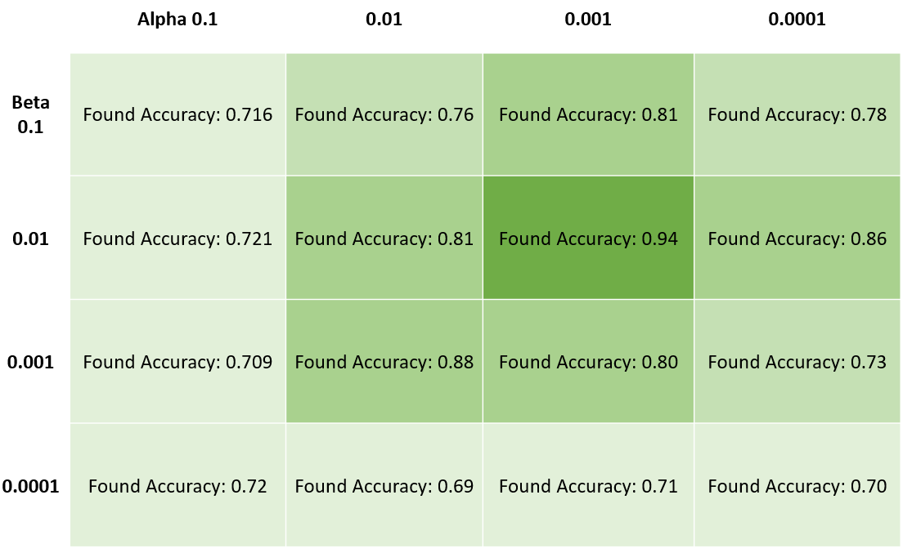

Slide 54
Robust regression(outliers)
Huber regression(change inloss function )
Bayesian Regression
Isotonic Regression

Slide 55
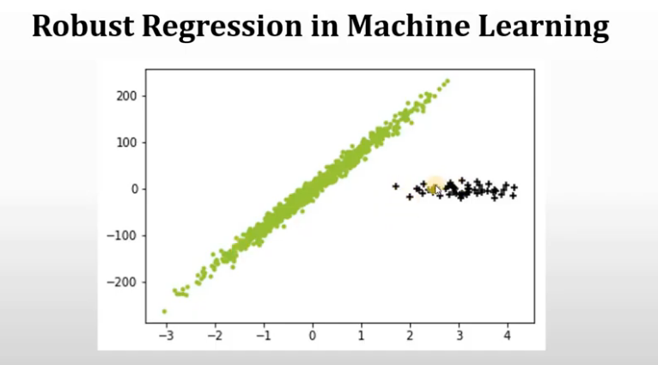
Robust regression

Slide 56
Contd…
RANSAC Regression
RANSAC (RANdom SAmple Consensus) algorithm.
RANSAC algorithm divides data in two subsets : outlier and inlier, then it uses inlier set to fit model. After fitting model to hypothetical inliers, it checks which elements in current set are consistent with original dataset with estimated parameters and if it is the case, it updates current subset. RANSAC algorithm continues iterating until inlier subset is large enough.

Slide 57
Huber Regression
HuberRegressor model
Huber loss is a loss function used in robust regression that is less sensitive to outliers in data than the squared error loss. The Hubber Regressor provided by scikit-learn optimizes the squared loss and absolute loss for the samples based on epsilon, where epsilon is a parameter to control the number of samples which should be treated as outliers.

Slide 58
Bayesian Regression
In the Bayesian viewpoint, we formulate linear regression using probability distributions rather than point estimates. The response, y, is not estimated as a single value, but is assumed to be drawn from a probability distribution.

Slide 59
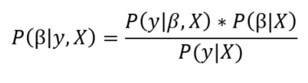
The aim of Bayesian Linear Regression is not to find the single “best” value of the model parameters, but rather to determine the posterior distribution for the model parameters. The posterior probability of the model parameters is conditional upon the training inputs and outputs

Slide 60
Isotonic regression
Isotonic regression is a free-form linear model that can be fit to predict sequences of observations. However, there are two major differences between isotonic regression and a similar model like weighted least squares. An isotonic function must not be non-decreasing. This is because an isotonic function is a monotonic function, meaning a function that preserves or reverses a given order.

Slide 61
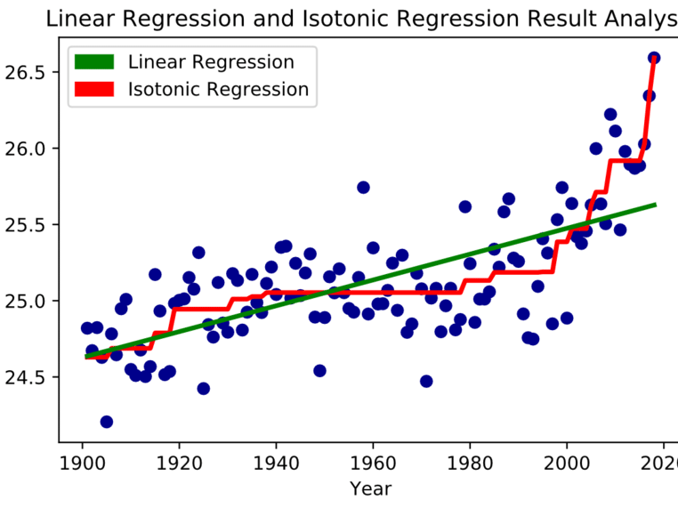

Slide 62
Feature selection
Feature selection is primarily focused on removing non-informative or redundant predictors from the model.
Feature selection is the method of reducing data dimension while doing predictive analysis. One major reason is that machine learning follows the rule of “garbage in-garbage out” and that is why one needs to be very concerned about the data that is being fed to the model.

Slide 63
Feature Selection Methods
Filter Method
Wrapper Method
Embedded Method

Slide 64
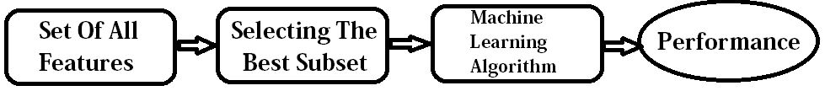
Filter Method

Slide 65
Wrapper Methods
Forward Selection: Forward selection is an iterative method in which we start with having no feature in the model. In each iteration, we keep adding the feature which best improves our model till an addition of a new variable does not improve the performance of the model.
Backward Elimination: In backward elimination, we start with all the features and removes the least significant feature at each iteration which improves the performance of the model. We repeat this until no improvement is observed on removal of features.
Recursive Feature elimination: It is a greedy optimization algorithm which aims to find the best performing feature subset. It repeatedly creates models and keeps aside the best or the worst performing feature at each iteration. It constructs the next model with the left features until all the features are exhausted. It then ranks the features based on the order of their elimination.

Slide 66
Feature selection and filtering

Slide 68
Embedded Methods
Some examples of Embedded Methods are mentioned below:
L1 Regularisation Technique such as LASSO: Least Absolute Shrinkage and Selection Operator (LASSO) is a linear model which estimates sparse coefficients and is useful in some contexts due to its tendency to prefer solutions with fewer parameter values.
Ridge Regression (L2 Regularisation): The L2 Regularisation is also known as Ridge Regression or Tikhonov Regularisation which solves a regression model where the loss function is the linear least squares function and regularisation.
Elastic Net: This linear regression model is trained with L1 and L2 as regulariser which allows for learning a sparse model where few of the weights are non-zero like Lasso and on the other hand maintaining the regularisation properties of Ridge.

Slide 69
Techniques
1. Univariate Selection
2. Feature Importance
3.Correlation Matrix with Heatmap

Slide 70
Principal Component Analysis (PCA)
is a statistical procedure that uses an orthogonal transformation which converts a set of correlated variables to a set of uncorrelated variables.
PCA is a most widely used tool in exploratory data analysis and in machine learning for predictive models.
PCA is an unsupervised statistical technique used to examine the interrelations among a set of variables.
It is also known as a general factor analysis where regression determines a line of best fit.

